Slide 1
TREES

Slide 2
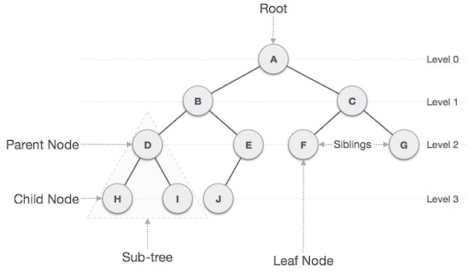
A tree structure means that the data are organized so that items of information are related by branches

Slide 3
Tree Terminology
Root: node without parent (A)
Siblings: nodes share the same parent
Internal node: node with at least one child (A, B, C, F)
External node (leaf ): node without children (E, I, J, K, G, H, D)
Ancestors of a node: parent, grandparent, grand-grandparent, etc.
Descendant of a node: child, grandchild, grand-grandchild, etc.
Depth of a node: number of ancestors
Height of a tree: maximum depth of any node (3)
Degree of a node: the number of its children
Degree of a tree: the maximum number of its node.
Subtree: tree consisting of a node and its descendants
A
subtree
B
C
D
E
F
G
H
I
J
K

Slide 4
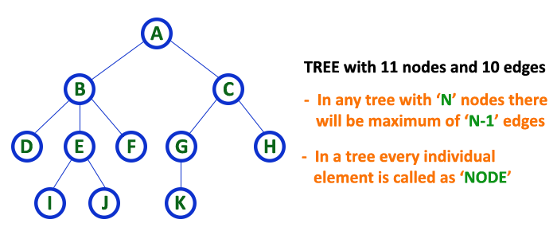
Tree is a non-linear data structure which organizes data in hierarchical structure and this is a recursive definition.
Tree data structure is a collection of data (Node) which is organized in hierarchical structure and this is a recursive definition
In tree data structure, every individual element is called as Node. Node in a tree data structure, stores the actual data of that particular element and link to next element in hierarchical structure. In a tree data structure, if we have N number of nodes then we can have a maximum of N-1 number of links.
Example

Slide 5
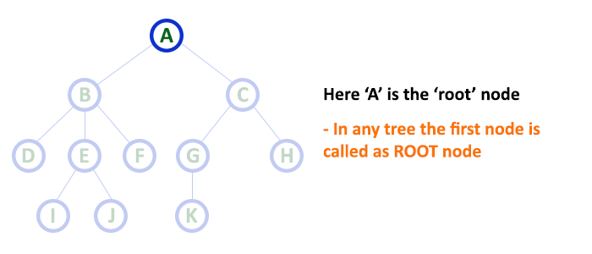
Root
In a tree data structure, the first node is called as Root Node. Every tree must have root node. We can say that root node is the origin of tree data structure. In any tree, there must be only one root node. We never have multiple root nodes in a tree.

Slide 6
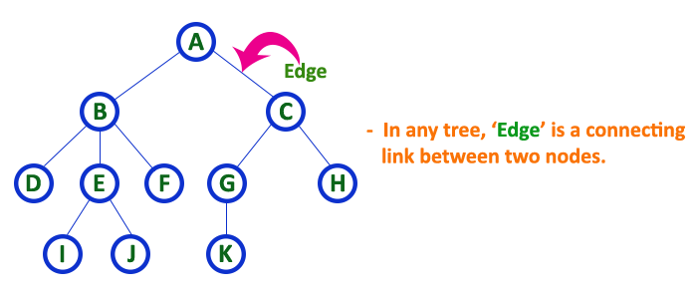
Edge
In a tree data structure, the connecting link between any two nodes is called as EDGE. In a tree with 'N' number of nodes there will be a maximum of 'N-1' number of edges.

Slide 7
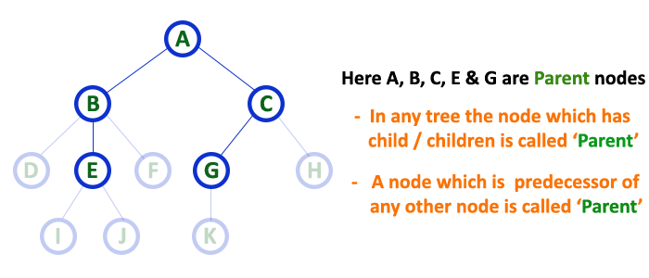
Parent
In a tree data structure, the node which is predecessor of any node is called as PARENT NODE. In simple words, the node which has branch from it to any other node is called as parent node. Parent node can also be defined as "The node which has child / children".

Slide 8
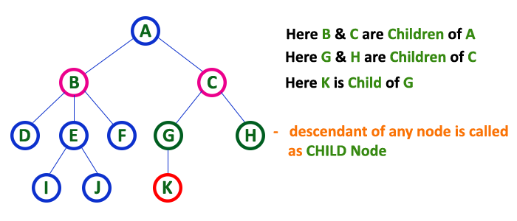
Child
In a tree data structure, the node which is descendant of any node is called as CHILD Node. In simple words, the node which has a link from its parent node is called as child node. In a tree, any parent node can have any number of child nodes. In a tree, all the nodes except root are child nodes.

Slide 9
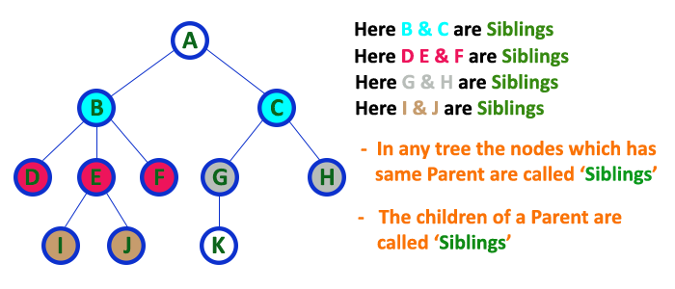
Siblings
In a tree data structure, nodes which belong to same Parent are called as SIBLINGS. In simple words, the nodes with same parent are called as Sibling nodes.

Slide 10
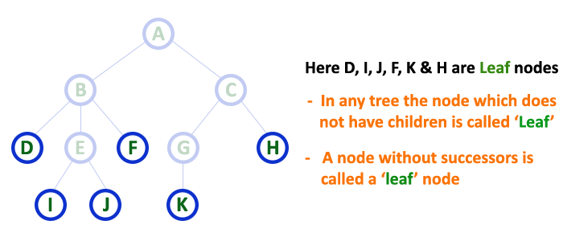
Leaf
In a tree data structure, the node which does not have a child is called as LEAF Node. In simple words, a leaf is a node with no child. In a tree data structure, the leaf nodes are also called as External Nodes. External node is also a node with no child. In a tree, leaf node is also called as 'Terminal' node.

Slide 11
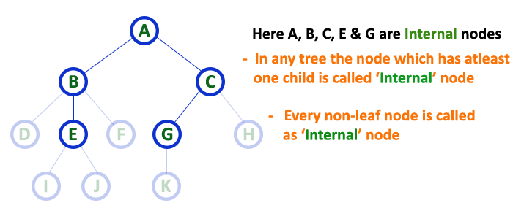
Internal Nodes
In a tree data structure, the node which has atleast one child is called as INTERNAL Node. In simple words, an internal node is a node with atleast one child. In a tree data structure, nodes other than leaf nodes are called as Internal Nodes. The root node is also said to be Internal Node if the tree has more than one node. Internal nodes are also called as 'Non-Terminal' nodes.

Slide 12
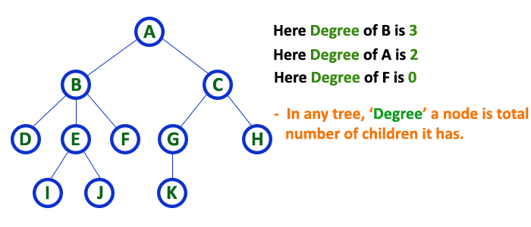
Degree
In a tree data structure, the total number of children of a node is called as DEGREE of that Node. In simple words, the Degree of a node is total number of children it has. The highest degree of a node among all the nodes in a tree is called as 'Degree of Tree'

Slide 13
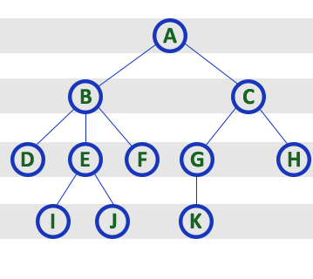
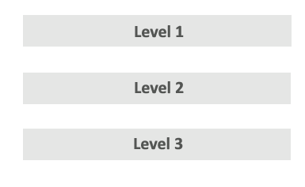

Level
In a tree data structure, the root node is said to be at Level 1 and the children of root node are at Level 2 and the children of the nodes which are at Level 2 will be at Level 3 and so on... In simple words, in a tree each step from top to bottom is called as a Level and the Level count starts with ‘1' and incremented by one at each level (Step).

Slide 14
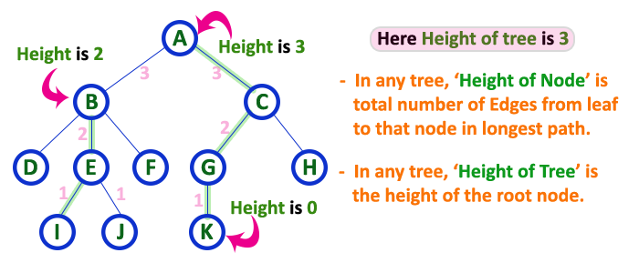
Height
In a tree data structure, the total number of edges from leaf node to a particular node in the longest path is called as HEIGHT of that Node. In a tree, height of the root node is said to be height of the tree. In a tree, height of all leaf nodes is '0'.

Slide 15
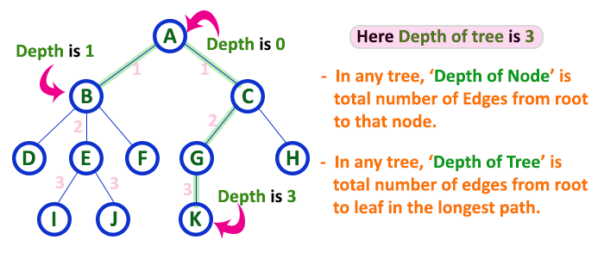
Depth
In a tree data structure, the total number of edges from root node to a particular node is called as DEPTH of that Node. In a tree, the total number of edges from root node to a leaf node in the longest path is said to be Depth of the tree. In simple words, the highest depth of any leaf node in a tree is said to be depth of that tree. In a tree, depth of the root node is '0'.

Slide 16
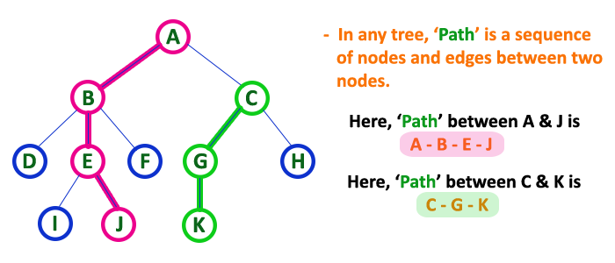
Path
In a tree data structure, the sequence of Nodes and Edges from one node to another node is called as PATH between that two Nodes. Length of a Path is total number of nodes in that path. In below example the path A - B - E - J has length 4.

Slide 17
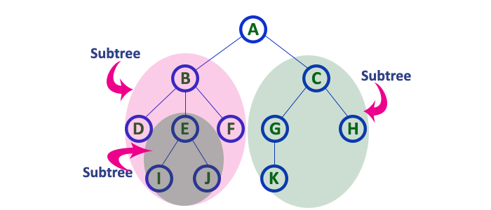
Sub Tree
In a tree data structure, each child from a node forms a subtree recursively. Every child node will form a subtree on its parent node.

Slide 18
Tree Properties
Property Value
Number of nodes
Height
Root Node
Leaves
Interior nodes
Ancestors of H
Descendants of B
Siblings of E
Right subtree of A
Degree of this tree
A
B
C
D
E
F
G
H
I

Slide 19
Example
A is the root node
B is the parent of D and E
C is the sibling of B
D and E are the children of B
D, E, F, G, I are external nodes, or leaves
A, B, C, H are internal nodes
The level of E is 3
The height (depth) of the tree is 4
The degree of node B is 2
The degree of the tree is 3
The ancestors of node I is A, C, H
The descendants of node C is F, G, H, I
Property: (# edges) = (#nodes) - 1
Level
A
1
B
C
2
H
3
D
E
F
G
I
4

Slide 20
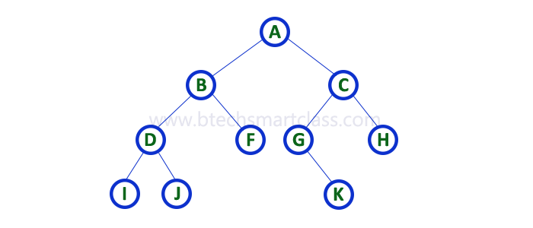
Binary Tree
In a normal tree, every node can have any number of children. Binary tree is a special type of tree data structure in which every node can have a maximum of 2 children. One is known as left child and the other is known as right child.
A tree in which every node can have a maximum of two children is called as Binary Tree.
In a binary tree, every node can have either 0 children or 1 child or 2 children but not more than 2 children.

Slide 21
Types of Binary Tree
Strictly Binary Tree
Complete Binary Tree
Extended Binary Tree

Slide 22
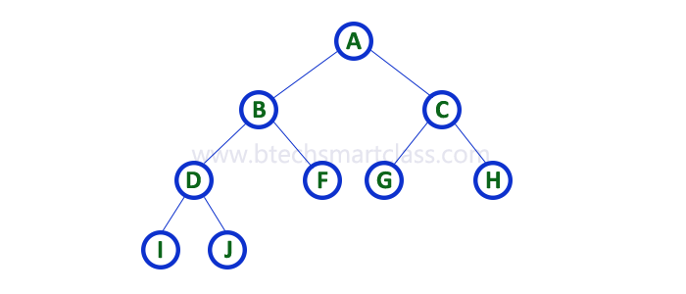
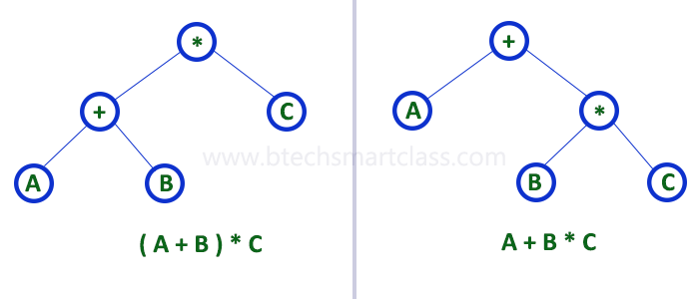
Strictly Binary Tree
A binary tree in which every node has either two or zero number of children is called Strictly Binary Tree
Strictly binary tree is also called as Full Binary Tree or Proper Binary Tree or 2-Tree
Strictly binary tree data structure is
used to represent mathematical expressions.

Slide 23
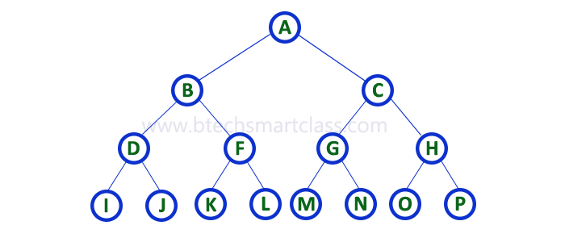
Complete Binary Tree
A binary tree in which every internal node has exactly two children and all leaf nodes are at same level is called Complete Binary Tree.

Slide 24
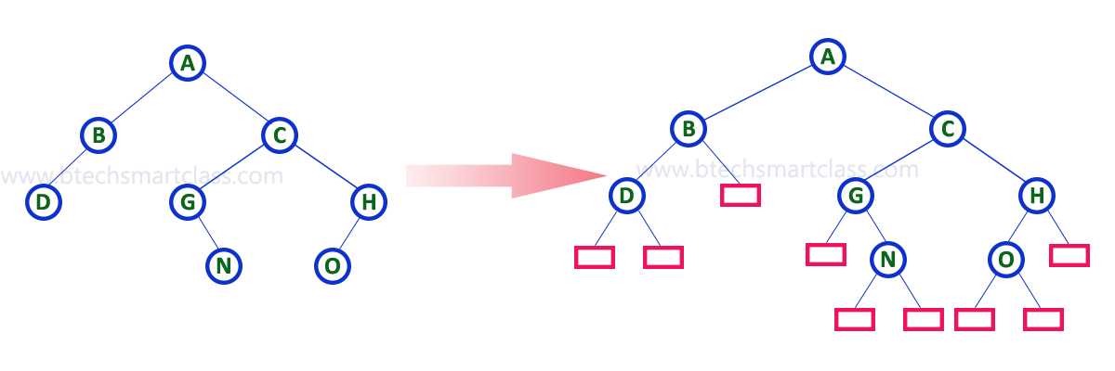
Extended Binary Tree
The full binary tree obtained by adding dummy nodes to a binary tree is called as Extended Binary Tree.

Slide 25
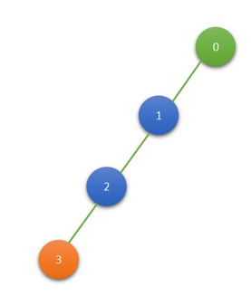
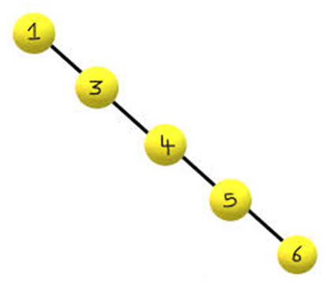
Skewed Binary Tree
Right Skewed Binary Tree
Left Skewed BT

Slide 26
Binary Tree Representations
Array Representation
Linked List Representation

Slide 27

Array Representation

Slide 28

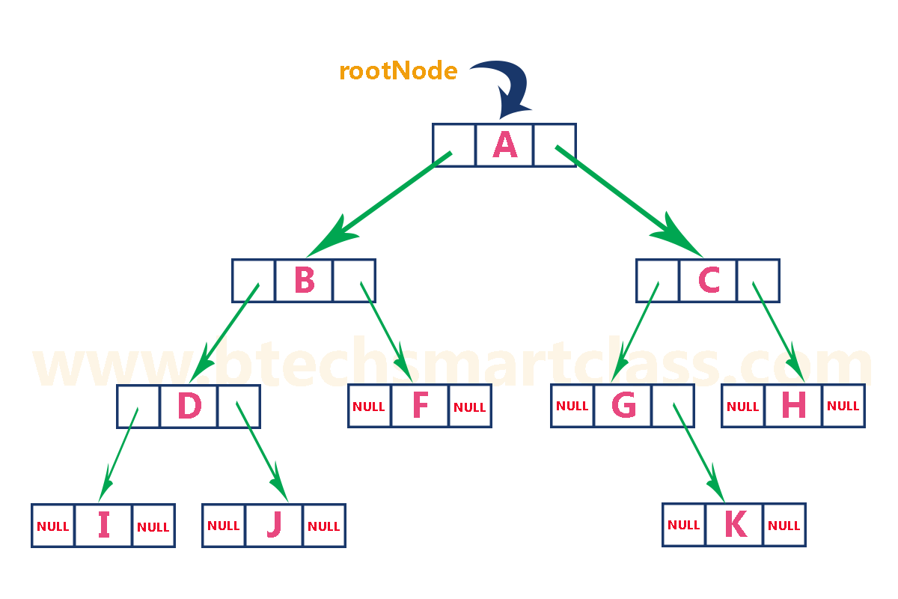
Linked List Representation

